Slide 1
Human Activity Recognition using Smart-Devices
Team:
Aakanksha NS, Roja I, Sakshi S, Shreejaya B Akansha,S. Ivette S.

Slide 2
Data & Analytic goals
Related work
Preprocessing & Machine Learning
Conclusions
OVERVIEW

Slide 3
What is Human Activity Recognition?
Predict what a person is doing using the sensor data
Activities such as sitting, standing, going upstairs, eating, etc.
Applications:
Healthcare
Sports training
Abnormal behavior detection
Notes:
For example, a study showed certain activities are more beneficial to the bones of premenopausal women

Slide 4
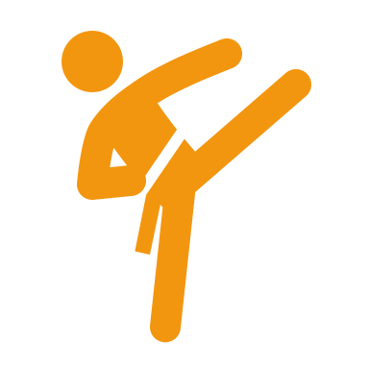
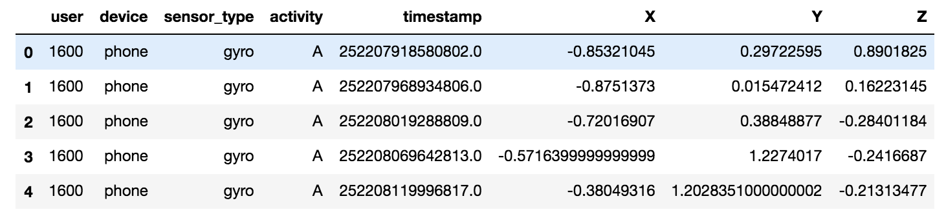
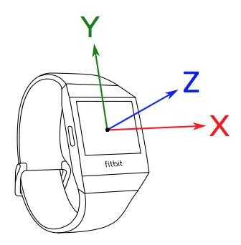
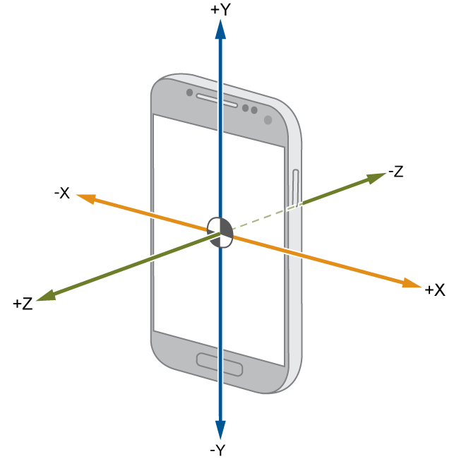
51 subjects
Our dataset
18 activities:
Non hand-oriented: walking, jogging, stairs, standing, kicking
Hand-oriented (G): dribbling, playing catch, typing, writing, clapping, brushing teeth, folding clothes
Hand-oriented (E): eating pasta, eating soup, eating sandwich, eating chips, drinking
15.6
million records
2 devices & 2 sensor types :
phone & watch / gyroscope & accelerometer
Source: UCI machine learning repository
X,Y, Z coordinates
Notes:
Non-hand-oriented activities:
{walking, jogging, stairs, standing, kicking}
Hand-oriented activities (General):
{dribbling, playing catch, typing, writing, clapping, brushing teeth, folding clothes}
Hand-oriented activities (eating):
{eating pasta, eating soup, eating sandwich, eating chips, drinking}

Slide 5
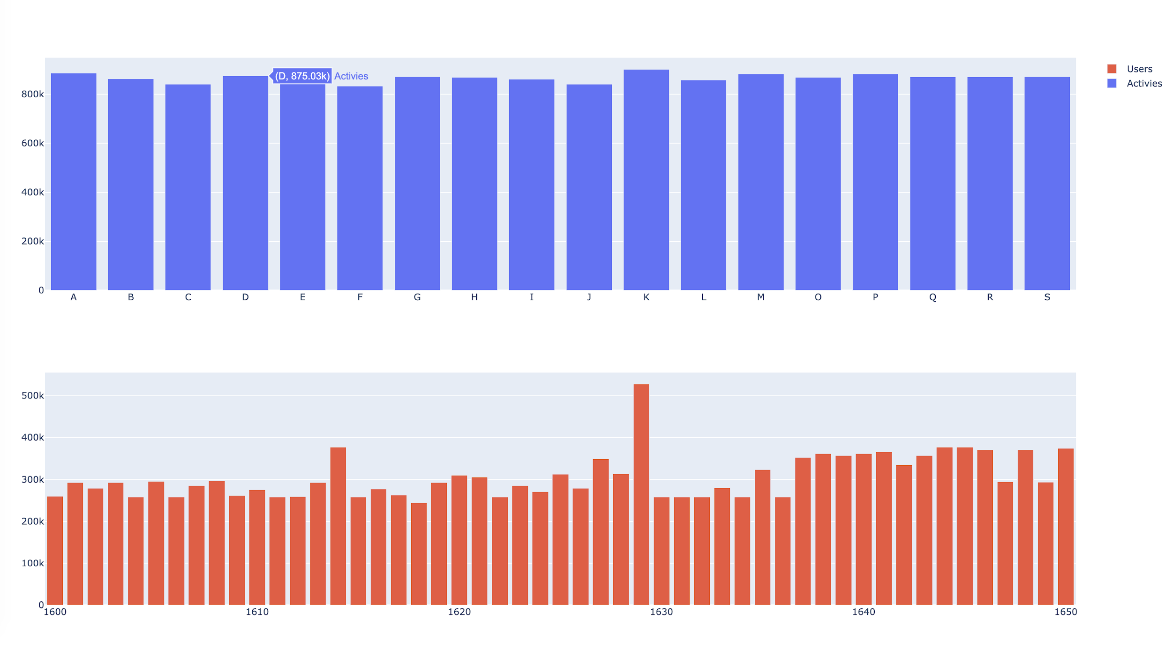
Distribution of activities

Slide 6
Analytic goals
Notes:
Non-hand-oriented activities:
{walking, jogging, stairs, standing, kicking}
Hand-oriented activities (General):
{dribbling, playing catch, typing, writing, clapping, brushing teeth, folding clothes}
Hand-oriented activities (eating):
{eating pasta, eating soup, eating sandwich, eating chips, drinking}

Slide 7
Our analytic goal
Which device-algorithm combination is the best to predict human activities?

Slide 8
Related work
Notes:
Non-hand-oriented activities:
{walking, jogging, stairs, standing, kicking}
Hand-oriented activities (General):
{dribbling, playing catch, typing, writing, clapping, brushing teeth, folding clothes}
Hand-oriented activities (eating):
{eating pasta, eating soup, eating sandwich, eating chips, drinking}

Slide 9
Smartphone and Smartwatch-Based Biometrics Using Activities
Culture as a sensor for HAR
Fordham University
International Journal of Social Robotics
Driver behavior monitoring on smarthphone sensor
Driver behavior monitoring on smarthphone sensor
HAR using accelerometer from smartphones
Lindow, Friedrich, and Alexey Kashevnik
Lindow, Friedrich, and Alexey Kashevnik
Bayat, A., Pomplun, M., & Tran, D.
Deep learning for Sensor-based activity recognition
HAR using smartphones
Wang, Jindong
Robert-Andrei Voicu, Ciprian Dobre, Lidia Bajenaru, and Radu-Ioan Ciobanu

Slide 10
OUR APPROACH
PAST RESEARCH
Cultural factors (limited to 3 regions)
Detecting abnormal behaviour
Best sensor placement
Biometric authentication
Find best device-algorithm combination to recognize activity.
Using distributed computing with Spark + H2O.

Slide 11
Preprocessing
Notes:
Non-hand-oriented activities:
{walking, jogging, stairs, standing, kicking}
Hand-oriented activities (General):
{dribbling, playing catch, typing, writing, clapping, brushing teeth, folding clothes}
Hand-oriented activities (eating):
{eating pasta, eating soup, eating sandwich, eating chips, drinking}

Slide 12
Preprocessing
We created new features!
Mean
Standard deviation
Covariance across the dimensions
Quantiles
Range (max – min)
Euclidean means
158 seconds
EMR setup
m5x.large
5 instances

Slide 13
Experiment setup & Modelling
Notes:
Non-hand-oriented activities:
{walking, jogging, stairs, standing, kicking}
Hand-oriented activities (General):
{dribbling, playing catch, typing, writing, clapping, brushing teeth, folding clothes}
Hand-oriented activities (eating):
{eating pasta, eating soup, eating sandwich, eating chips, drinking}

Slide 14
Experimentation setup
Devices
Phone
only
Watch
only
Phone + Watch
Modelled by
Deep
Learning
XGBoost
Random
Forest
Models
AutoML

Slide 15
Model results
Accuracies per device-model combination
Top 2 models
Phone+Watch
XGBoost
70.8%
Phone+Watch
Random Forest
69.6%

Slide 16
Time results
EMR Setup
Instance type: m5.xlarge
# instances: 5
Running time per device-model combination
Takeaways
AutoML: Time consuming
SparkML time <<< H2O time

Slide 17
Selected model
EMR setup benchmarking
Phone+Watch
Random Forest
# | Instance Specification | Time (sec.)
1 | m5a.2xlarge 4 instances | 83.31
2 | c5.9xlarge, 8 instances | 54.37
3 | c5.2xlarge 4 instances | 279.83
4 | m5.12xlarge 4 instances | 49.16
5 | c4.4xlarge, 8 instances | 59.61
6 | m5.xlarge, 5 instances | 138.03
Best EMR set up

Slide 18
Conclusions
Notes:
Non-hand-oriented activities:
{walking, jogging, stairs, standing, kicking}
Hand-oriented activities (General):
{dribbling, playing catch, typing, writing, clapping, brushing teeth, folding clothes}
Hand-oriented activities (eating):
{eating pasta, eating soup, eating sandwich, eating chips, drinking}

Slide 19
Conclusions
Device-sensor combination
We were able to best predict the activies using the sensor data from all the devices
Best ML algorithm
XGBoost : 70.8% (accuracy)
Least predictable activities
Hand-oriented activites like eating and drinking
AutoML experience
Running AutoML can be time-consuming and doesn’t guarantee the best results.
Notes:
We are able to best predict the activies using the sensor data from all the devices
The best ML algorithm for our dataset is “XGBoost”
Least predictable activities are hand related activities like eating, drinking across the devices
Automl not always give the best results

Slide 20
Thank you!

